Slide 1
2022 Year 7 Science Classifications – Week 2
By Miss Serafino

Slide 2
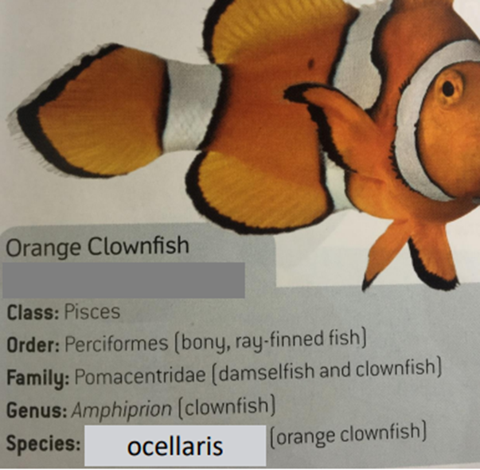

Recap
Scientist Carl Linnaeus
Introduced the Linnean Classifications System
Introduced Linnaeus Double-Naming (Binomial) System
The Genus (starting with a capital letter) and Species (starting with a lower case letter) is used to scientifically name an organisms.
Example: Amphiprion ocelllaris (Cownfish)
Importance of discovering new species?
→ Many medicines used come from organisms.
→ Example: antibiotics ‘Penicillin’ & ‘Aspirin’

Slide 3
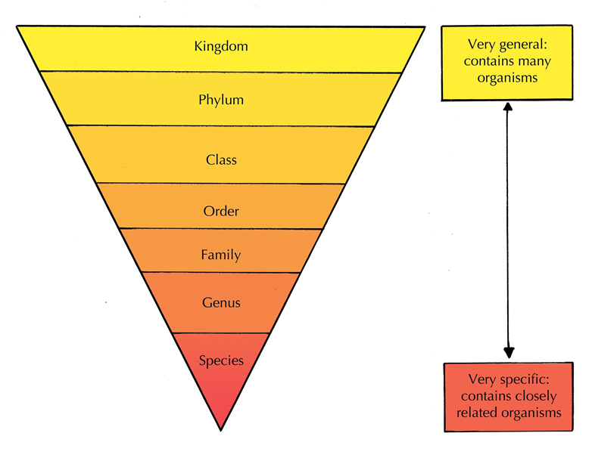
Recap
Classifications Hierarchy
“King Philip Crawled Over Four Gooey Snails”
Kingdom
Phylum
Class
Order
Family
Genus
Species

Slide 4
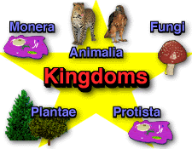
Recap
The 5 Kingdoms
Protista: single-celled organisms e.g., protozoa
Fungi: eukaryotic organisms e.g., mushrooms
Plantae: all living things that aren’t animals e.g., plants
Animalia: eukaryotic organisms e.g., animals
Monera: single-celled organisms e.g., bacteria

Slide 5
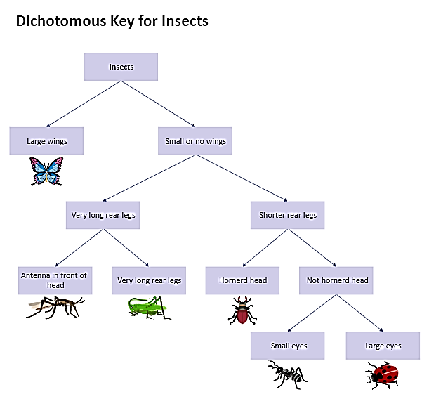
Recap
Dichotomous Key
A key with two choices at each stage, which aims to identify organisms based on their characteristics

Slide 6
Learning Outcomes
Tabular Keys
Classification of Plants

Slide 7
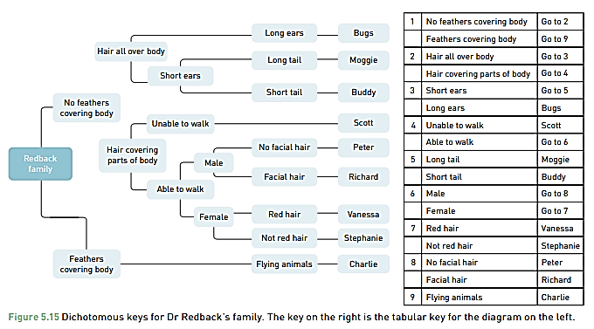
Tabular Keys
In a Tabular Key Each item presents 2 options. As you move down the table more information will be revealed until one of the organisms shown can be identified.

Slide 8
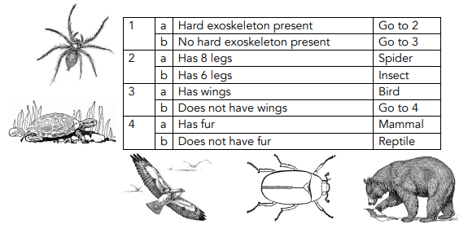
Tabular Key Example

Slide 9

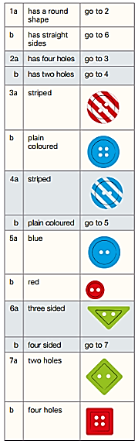
Tabular Key Example

Slide 10
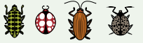
Your Turn! Make a Tubular Key
Questions you could ask:
Does it have spots?
Does it have stripes?
Does it have antennas?
Is it’s body shape round?

Slide 11
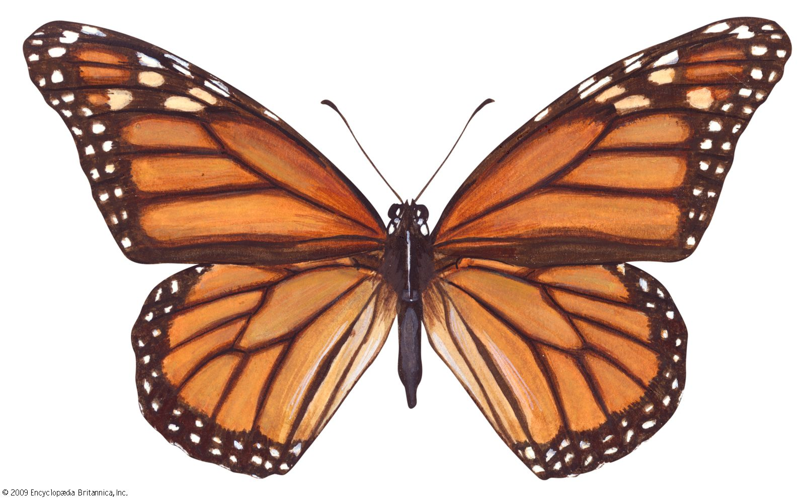
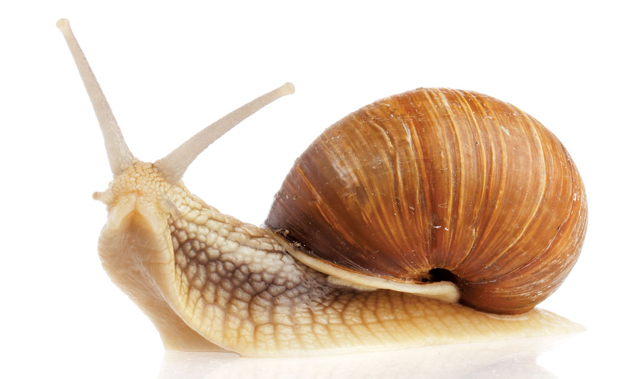
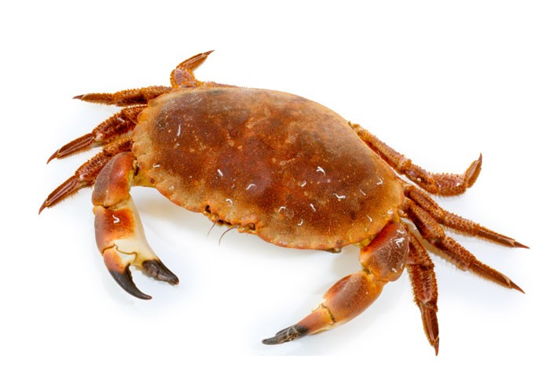
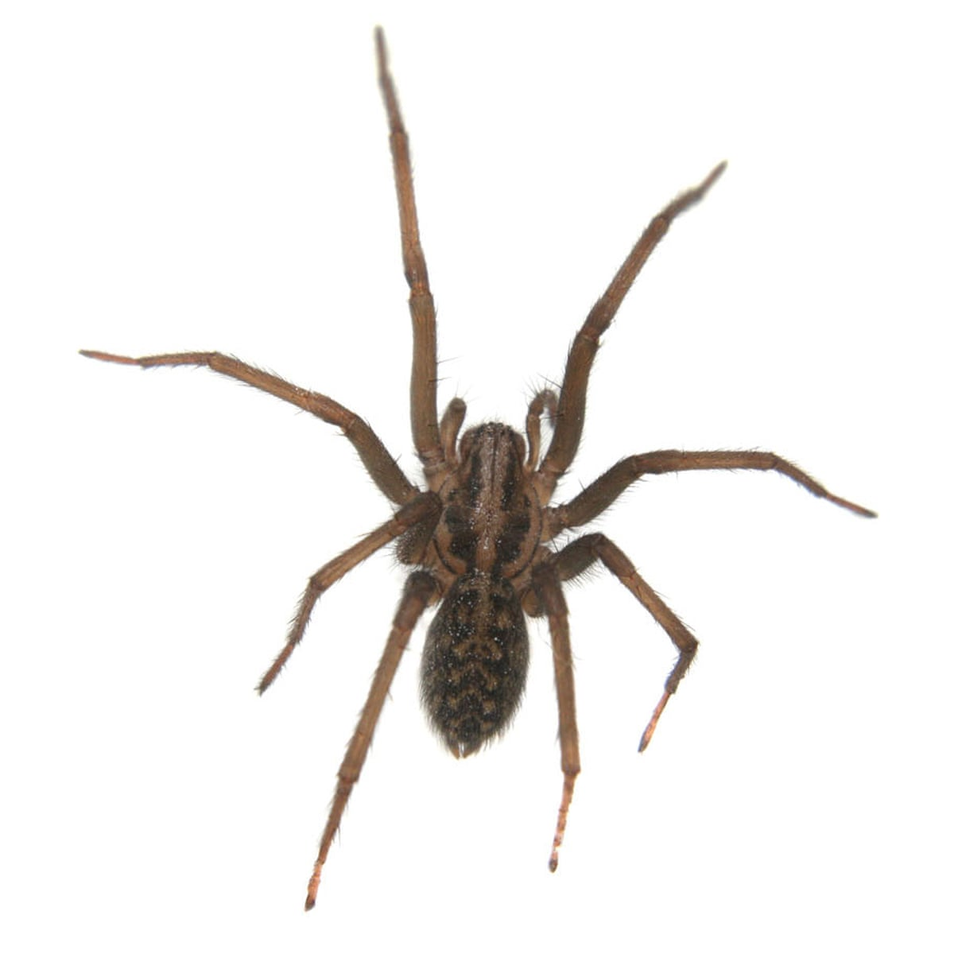
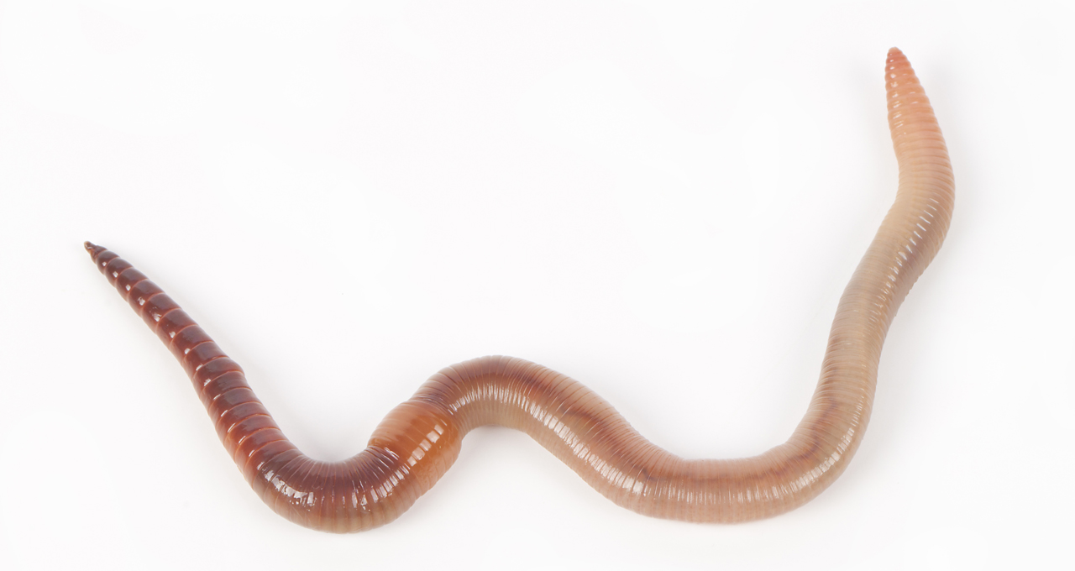
Your Turn! Make a Tubular Key
Questions you could ask:
Does it have wings?
Does it have legs?
Does it have a shell?
Does it have claws?
Does it have fur?

Slide 12
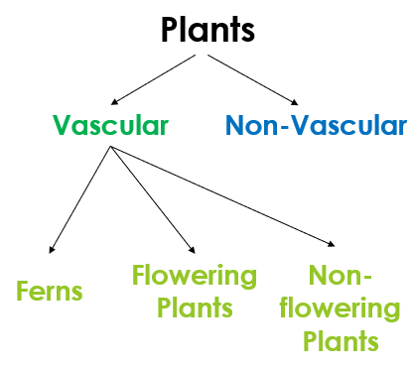
Introducing the Plantae Kingdom
The Plantae kingdom includes trees, vines, bushes, ferns, mosses, weeds and grasses.
They all gain energy by making their own food from sunlight (autotrophs).
They are multicellular, their cells have a nucleus inside and cell wall outside.
Botanists are the scientists who study the Plantae kingdom.

Slide 13
Non-Vascular
Non-Vascular
Non-Vascular plants do not have ant specialised cells in their roots and stems to transport water and nutrients from one part of the plant to another
Non-Vascular Characteristics
Cannot grow large or tall
Often found spread across rocks or in cool / moist / shaded areas
Reproduce using spores
Examples: moss & algae

Slide 14
Vascular
Vascular
Vascular plants have specialised vascular system. They consist of roots and stems for transporting water (xylem) and nutrients (phloem) around the plant.
Examples include: ferns, flowering plants and non-flowering plants.

Slide 15
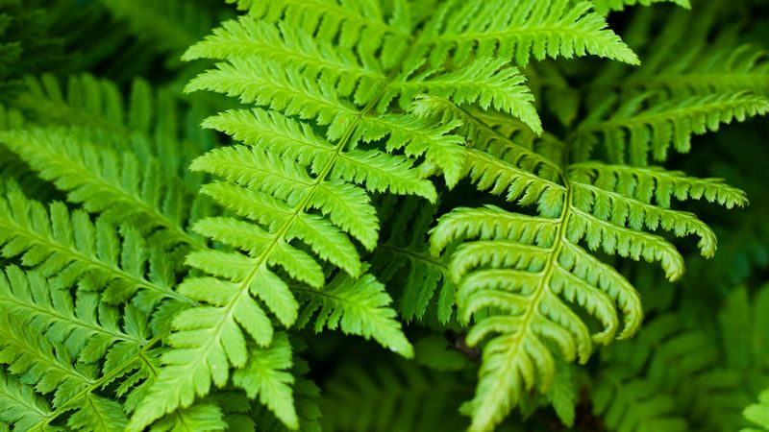
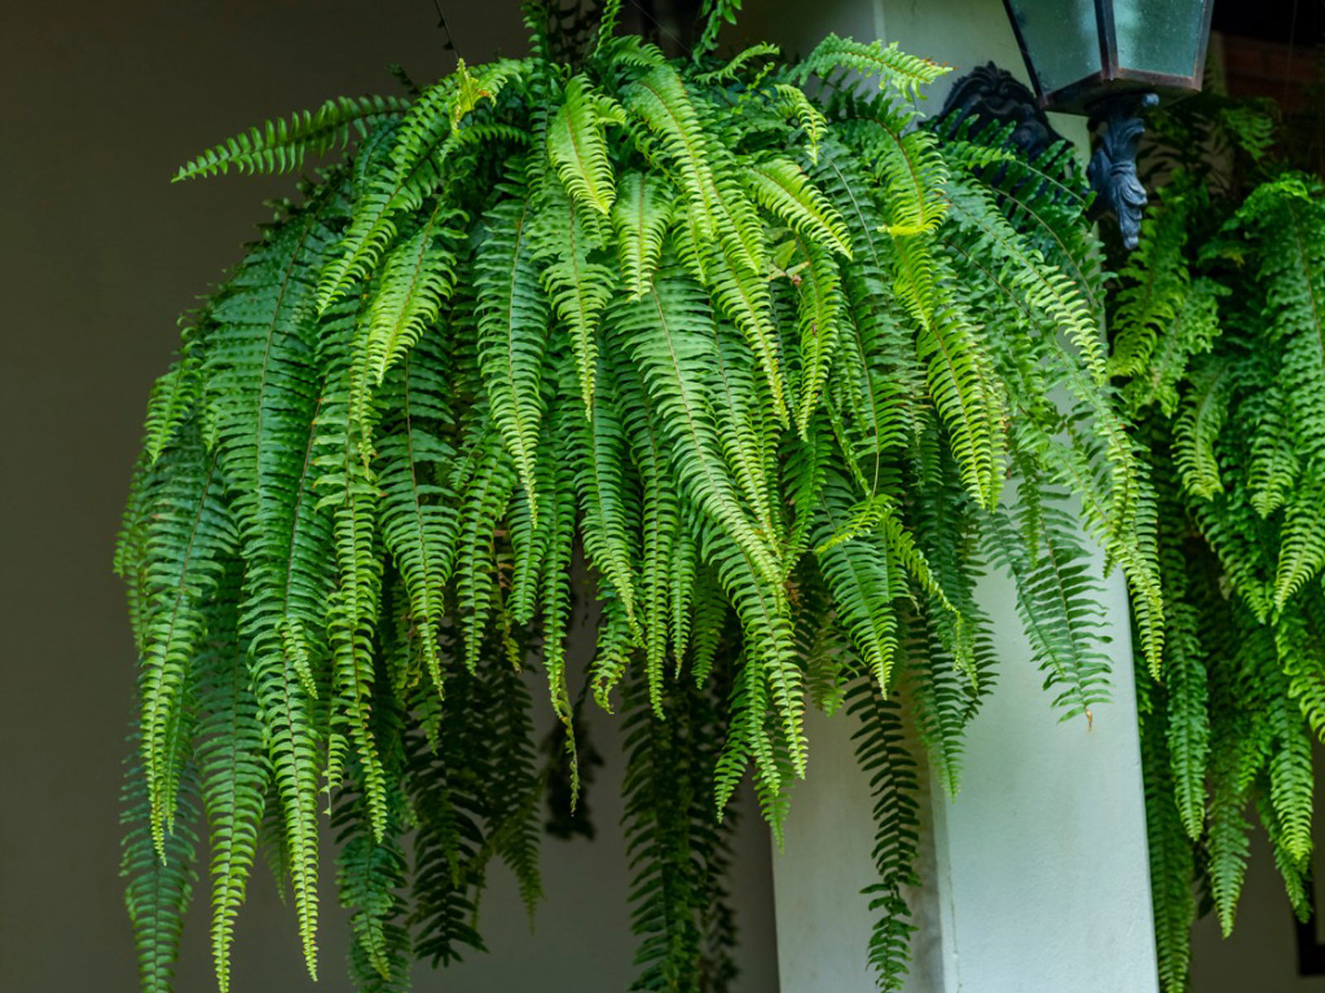
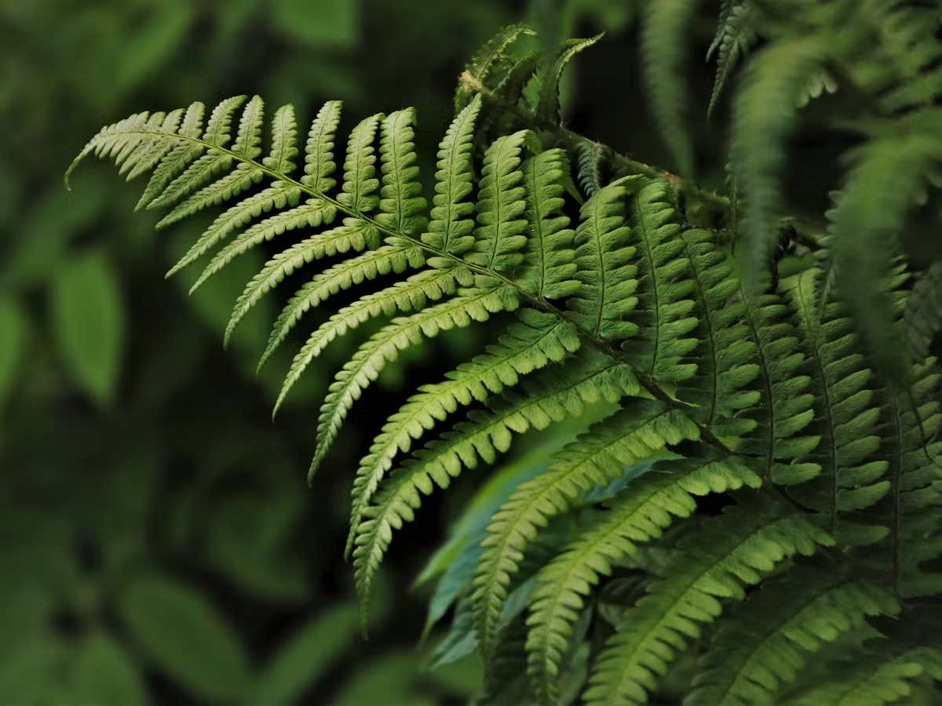
Fern Characteristics
Are vascularised (contain specialised cells xylem & phloem)
Can grow to large sizes
Reproduce using spores
Like moist / humid / shaded areas
Do not have seeds

Slide 16
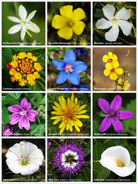
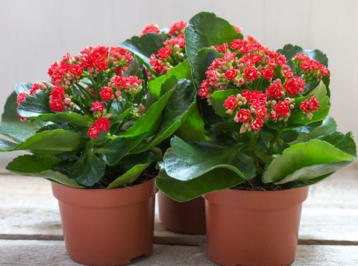
Flowering Plants Characteristics
Use bright coloured flowers and sweet nectar to lure insects, birds and other animals to the flower
Rely on animals and wind to help spread the flowers pollen to produce seeds
Develop seeds inside the fruit e.g., pods
Can possess fruit, so that when animals eat the fruit they spread the seeds over large distances
Vary in size from small to large
Can grow in wide range on environments

Slide 17
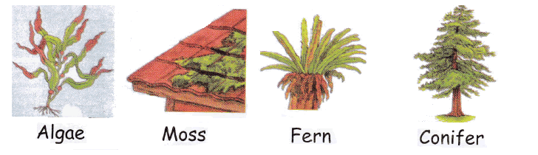
Non-flowering Plants Characteristics
Include cycads & conifers
→ Conifers produce cones that are male (contain pollen) or female (contain seeds)
Rely on wind to move pollen from the male cone to the female cone
Reproduce using seeds; which are protected by a waterproof layer to prevent the seed from drying out

